Slide 1
NLP Toolkit
ETL, Document Summarization, PII detection
and sentiment analysis.
Version 1 : 2022-09-02

Slide 2
NLP Toolkit
Functions
Agenda:
ETL function
Sentiment analysis
Document summarization
PII detection
Notebook link:
Databricks:
All_functions_import_test - Databricks (azuredatabricks.net)
GitHub repo:
ssc-dsai/nlp-exploration-notebooks (github.com)

Slide 3
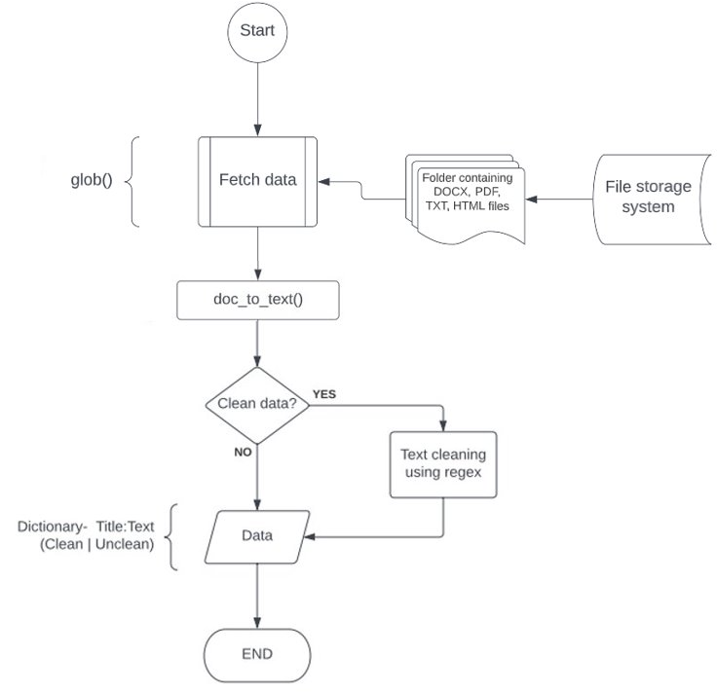
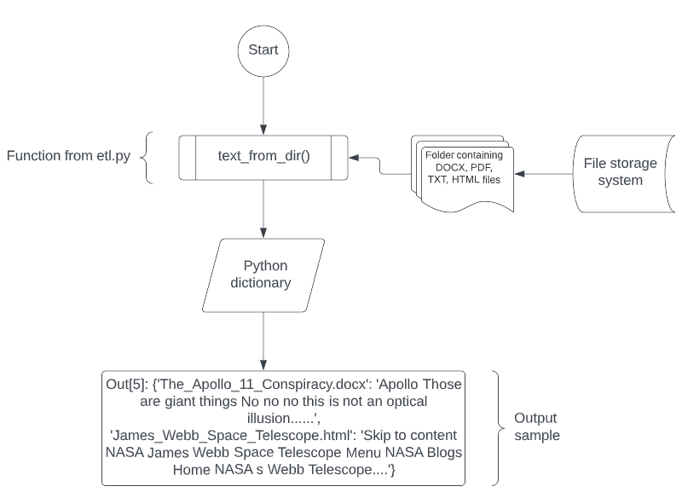
ETL – Docx, pdf, html, txt.
ETL function
ETL process flowchart:
1)
2)

Slide 4
Sentiment analysis using pre-trained deep learning models
Function execution
Model name: distilbert-base-uncased-finetuned-sst-2-english · Hugging Face​
Sample data: ​
The_Apollo_11_Conspiracy.docx (Size 14.5kb) ​
James_Webb_Space_Telescope.html (100 kb/ 9200 words approx.)​
Execution time: ​
Sentiment analysis for The_Apollo_11_Conspiracy.docx completed in: 0.32 seconds​
Sentiment analysis for James_Webb_Space_Telescope.html completed in: 2.49 seconds​
Observations: ​
This model has a binary output: Positive | Negative sentiments. It performed as expected. ​
​Published benchmark evaluation results: Accuracy of 91.3​
For detailed results, please visit: distilbert-base-uncased-finetuned-sst-2-english · Hugging Face ​

Slide 5
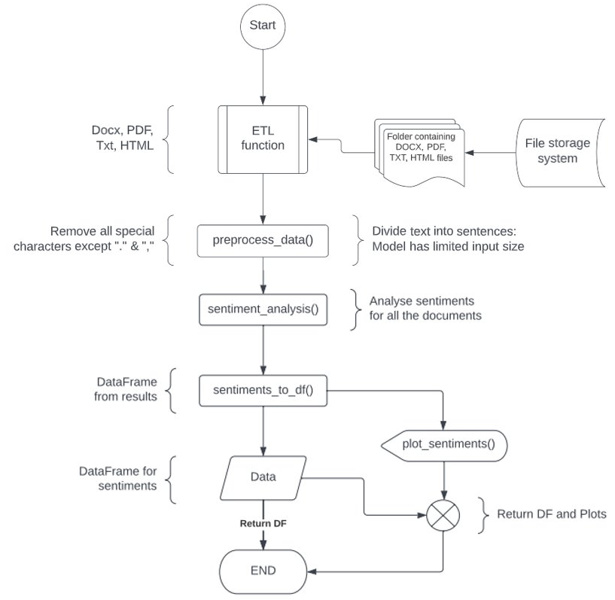
Sentiment analysis using pre-trained deep learning models
Sentiment analysis function
Sentiment analysis flowchart:

Slide 6
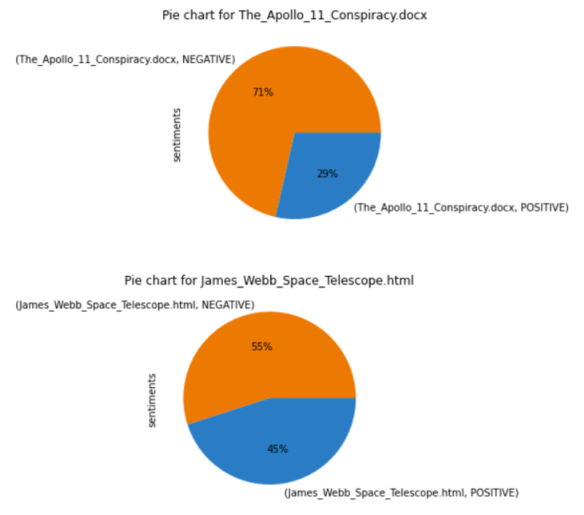
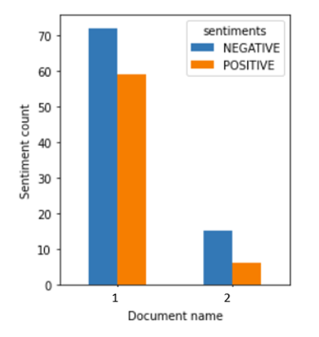
Sentiment analysis using pre-trained deep learning models
Function output
Plots: Distilbert-base-uncased-finetuned-sst-2-english

Slide 7
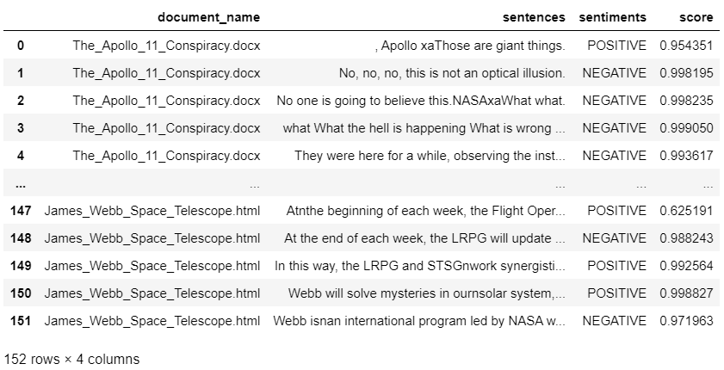
Sentiment analysis using pre-trained deep learning models
Function output
Data frame: Distilbert-base-uncased-finetuned-sst-2-english

Slide 8
Sentiment analysis using pre-trained deep learning models
Function execution
Model name: nlptown/bert-base-multilingual-uncased-sentiment · Hugging Face​
Sample data: ​
The_Apollo_11_Conspiracy.docx (Size 14.5kb) ​​
James_Webb_Space_Telescope.html (100 kb/ 9200 words approx.)​​
Execution time: ​​
Sentiment analysis for The_Apollo_11_Conspiracy.docx completed in: 0.56 seconds ​​
Sentiment analysis for James_Webb_Space_Telescope.html completed in: 5.43 seconds​​
Observations: ​​
This model has 1-to-5-star rating output: 1 Star being the most negative. 5 Star being the most positive. Please visit: nlptown/bert-base-multilingual-uncased-sentiment · Hugging Face
Roughly 2x of the execution time of the first model.
Language | Accuracy (Exact) | Accuracy(Off-by-1)
French | 59% | 94%
English | 67% | 95%

Slide 9
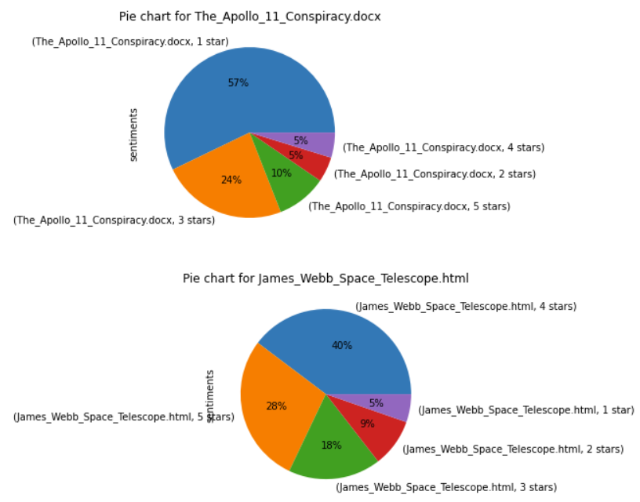
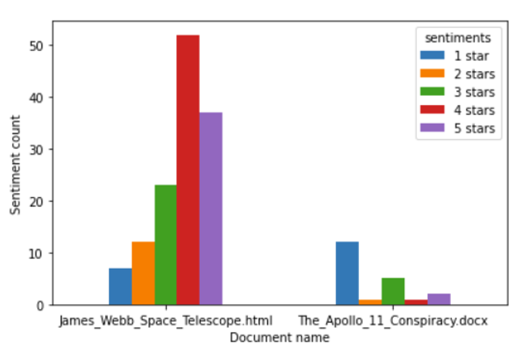
Sentiment analysis using pre-trained deep learning models
Function output
Plots: nlptown/bert-base-multilingual-uncased-sentiment

Slide 10
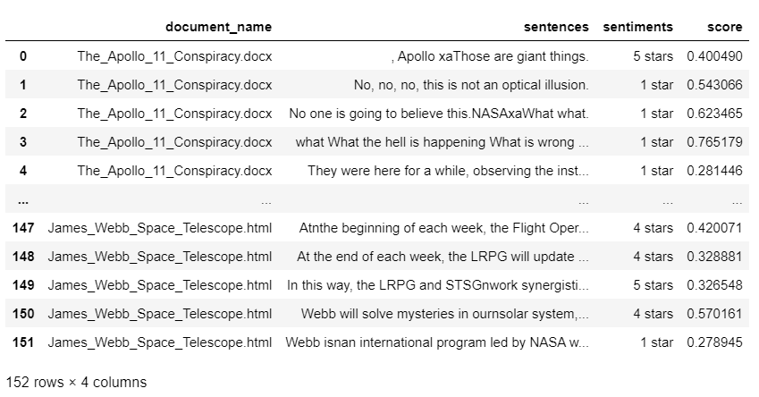
Sentiment analysis using pre-trained deep learning models
Function output
Data frame: Distilbert-base-uncased-finetuned-sst-2-english

Slide 11
Document summarization using pre-trained deep learning models
Function execution
Model name: knkarthick/MEETING_SUMMARY
Sample data and execution time:
Summarization for 2021-08-23 Doris Paquin (Spectrum) meeting notes.docx completed in 5.20 seconds
Summarization for ICT-ACR meeting notes 2020-11-12.docx completed in 5.82 seconds
Summarization for 2020-11-16 GSA USAB meeting notes.docx completed in 10.81 seconds
Summarization for ebidm-dsai meeting notes 2022-01-21.docx completed in 9.10 seconds
Summarization for 2022-06-15 Onyx demo from Curtis ONeil.txt completed in 2.96 seconds
Summarization for 2021-10-15 ESD assumptions meeting notes.txt completed in 2.03 seconds

Slide 12
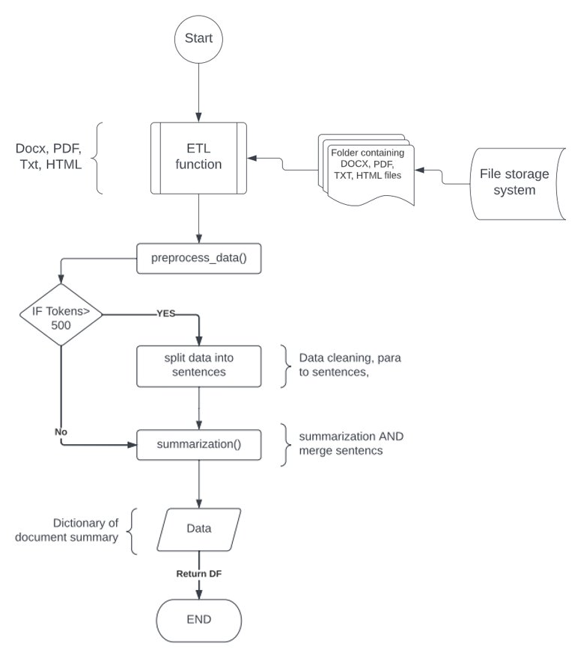
Document summarization using pre-trained deep learning models
Summarization function
Summarization flowchart:

Slide 13
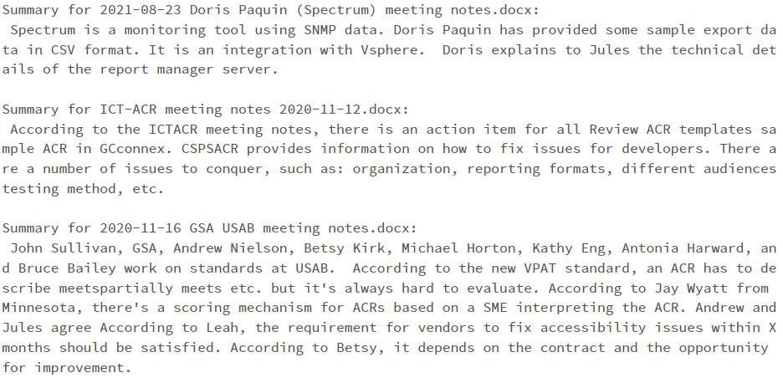
Document summarization using pre-trained deep learning models
Function output
Summarization output: knkarthick/MEETING_SUMMARY

Slide 14
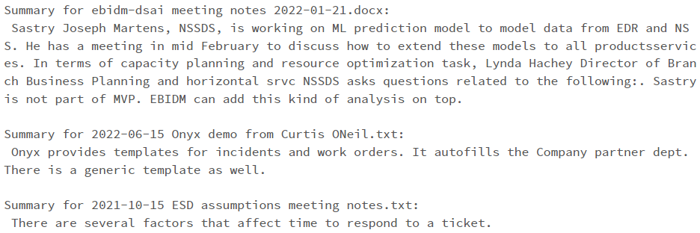
Document summarization using pre-trained deep learning models
Function output
Summarization output: knkarthick/MEETING_SUMMARY

Slide 15
PII detection using Presidio analyzer-AnalyzerEngine
Function execution
API: Presidio analyzer
Sample data and execution time:
PII analysis for ebidm-dsai meeting notes 2022-01-21.docx completed in 0.18 seconds
PII analysis for 2021-08-23 Doris Paquin (Spectrum) meeting notes.docx completed in 0.11 seconds
PII analysis for 2020-11-16 GSA USAB meeting notes.docx completed in 0.18 seconds
PII analysis for 2022-06-15 Onyx demo from Curtis ONeil.txt completed in 0.06 seconds

Slide 16
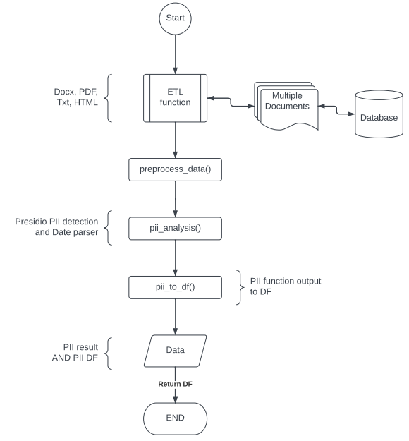
PII detection using Presidio analyzer-AnalyzerEngine
PII detection function
PII detection flowchart:
Flowchart.4

Slide 17
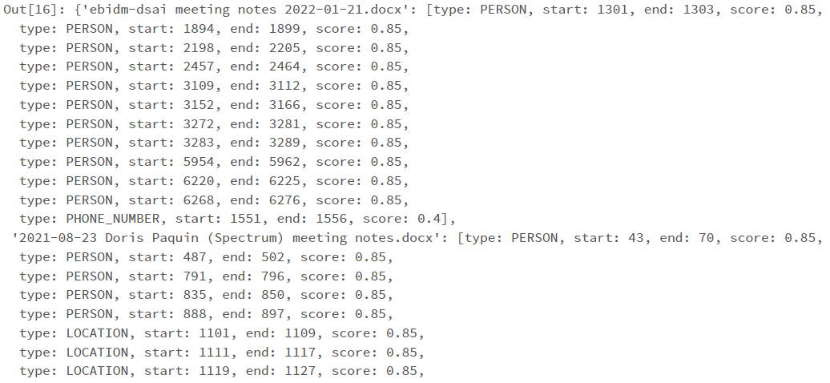
PII detection using Presidio analyzer-AnalyzerEngine
Function output
Presidio analyzer output:

Slide 18
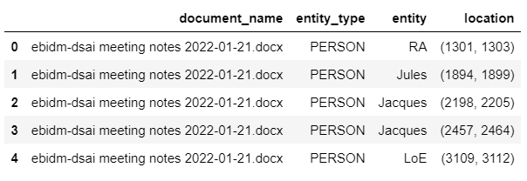
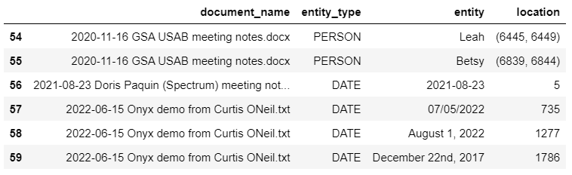
PII detection using Presidio analyzer-AnalyzerEngine
Function output
PII DataFrame:

Slide 19
Thank you

